Slide 1
TOTAL CLOUD COVERAGE PREDICTION
By -
Abhyudaya Nerwat
Kanishka Pujara
Shriji Singh
Utkarsh Srivastava

Slide 2
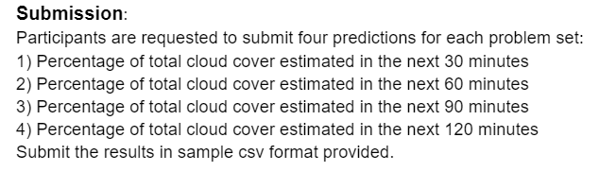
What exactly is our project?
Our task is to predict the total cloud coverage as a percentage of the open sky for a fixed field of view at 4 horizon intervals of 30, 60, 90 and 120 minutes from the historical data given in the project .

Slide 3
Dataset
We used only the data provided along with this project - csv file provided for train data, and 300 csv files provided for test data.
Link for dataset: https://he-public-data.s3.ap-southeast-1.amazonaws.com/shell_dataset.zip
Missing data handling -
All those rows where Total Cloud Coverage (%) column had -1 value were removed from the train dataset.
All those rows where Total Cloud Coverage (%) column had -7999 value were accommodated for by taking average of the surrounding values.
‘Precipitation (accumulated) [mm]’ and ‘moisture’ columns were removed as their data was irrelevant.

Slide 4
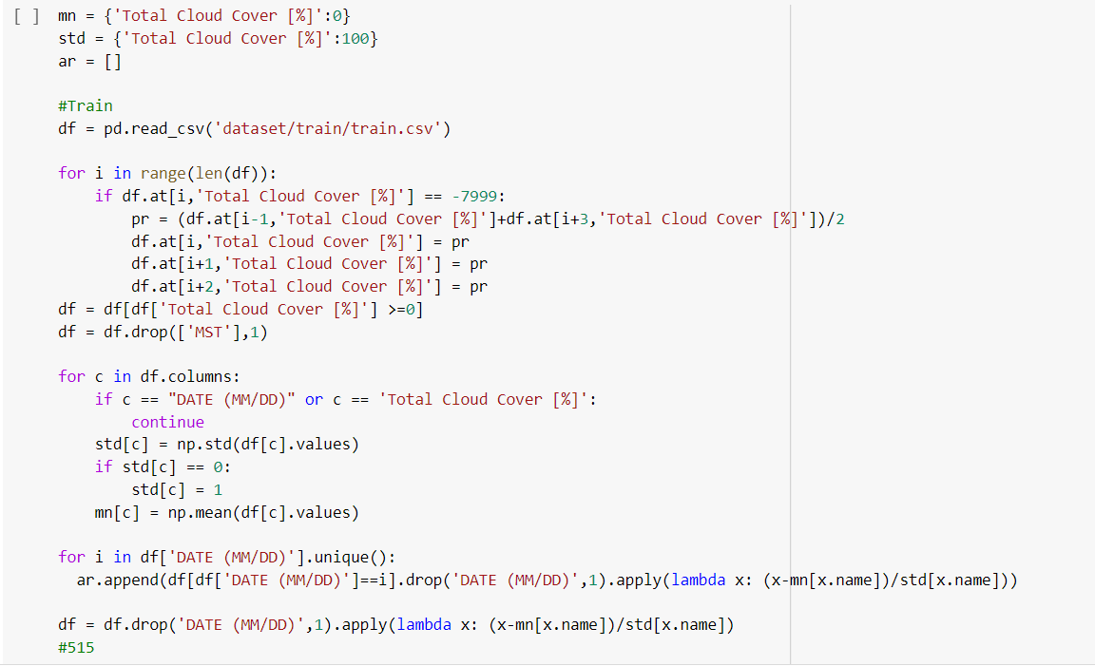

Slide 5
MODEL:LSTM
“LSTMs,” are a very special kind of recurrent neural network which works, for many tasks, much much better than the standard version: capable of learning long term dependencies.
In our project, we need to figure out the forecast of 30 min,60 min, 90 min and 120 min after a specified time, in cases like these LSTM is expected to give good results.
Just like RNNs,LSTMs have a chain like structure , but the repeating module has a different structure. Instead of having a single neural network layer, there are four, interacting in a very special way.

Slide 6


Slide 7
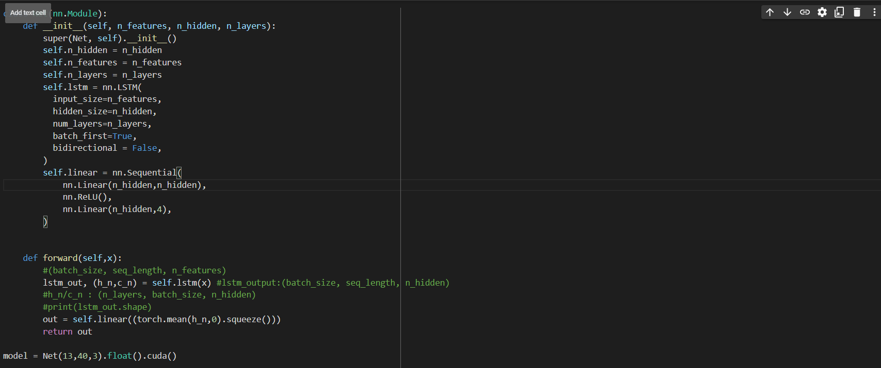

Slide 8
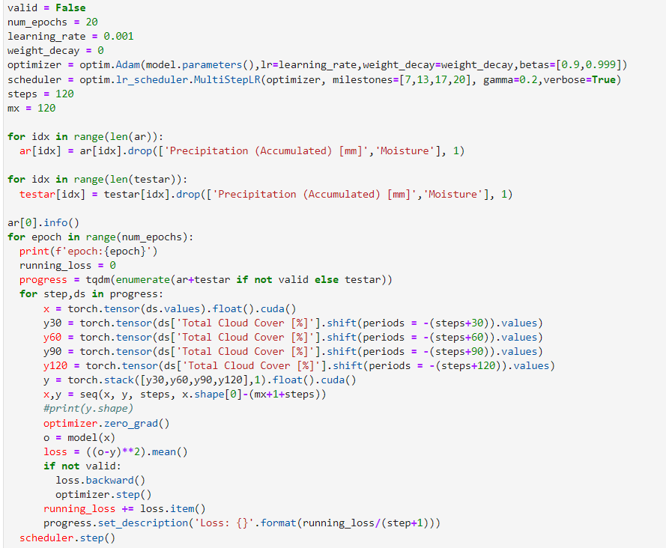
Prepare dataset for training and then training the model..

Slide 9
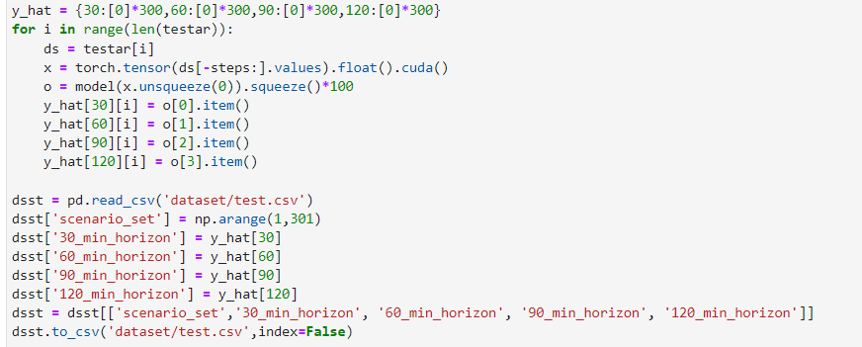
Testing the model..

Slide 10
